Slide 1
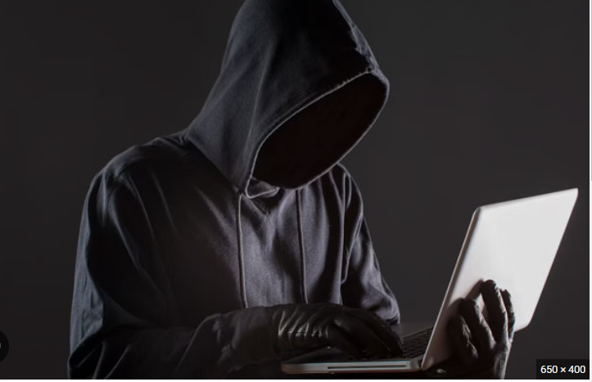
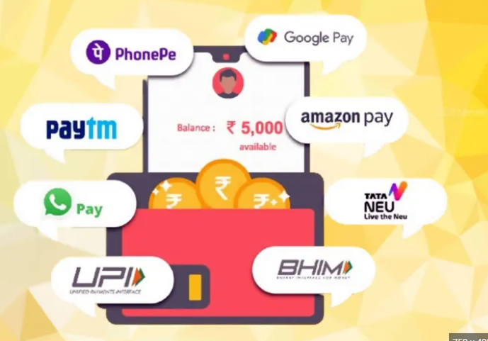
TOPIC- UPI PAYMENT FRAUD DATA SET
PRE-PLACEMENT PROJECT
NAME-SANJAY SHOME
MENTOR-MR.ASHISH RAJPUT

Slide 2
INDEX
TITLE
SLIDE NO
1) business objective
2) data-driven question
3) python question
4) tableau question
5) conclusion
3
4
5-7
8-11
12

Slide 3
BUSINESS OBJECTIVE
"Detect fraudulent transactions using transaction details to enhance security and protect customers from financial losses."

Slide 4
DATA-DRIVEN QUESTION
Python question
Tableau question
1) which types of transcations is more occurred?
2) in which years more no.of fraud transcations occurred?
3) in which months more no.of fraud transcations occurred?
4) in which weeks day more no. of fraud transcation occurred?
5) in which state more no.of fraud transcation occurred?
6) in which job more no.of truncation occurred?
7) methods of heat maps and correlation analysis.
8) monthly trend of upi transcations in month.
9) top 5 states of upi transcations.
10) distribution of transcation amount payment categories?
11) Top 10 jobs hightest graud transcations.
12) in which state more no.of fraud transcation occurred?
13) In which trans-date trans-trans fraud occurred more?
14) In which city has more fraud transcations?
15) In which merchants has more fraud transcations occurred?
16) In which category has the more fraud transcations occurred?
17) In which streets has more fraud transcations occured?
18) In which city has more fraud?
19) Which gender has more fraud?
20) In which last(columns) has more frauds?

Slide 5
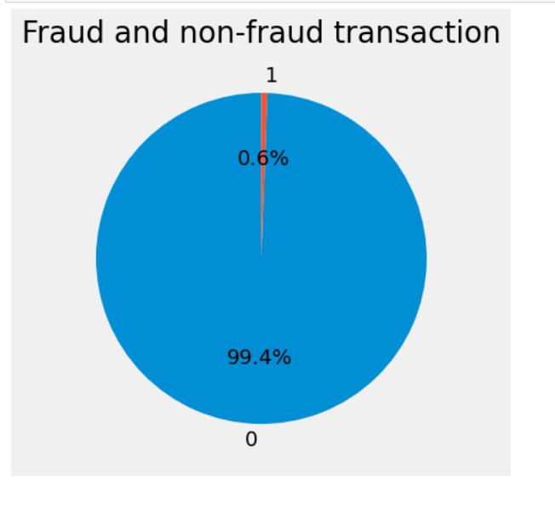
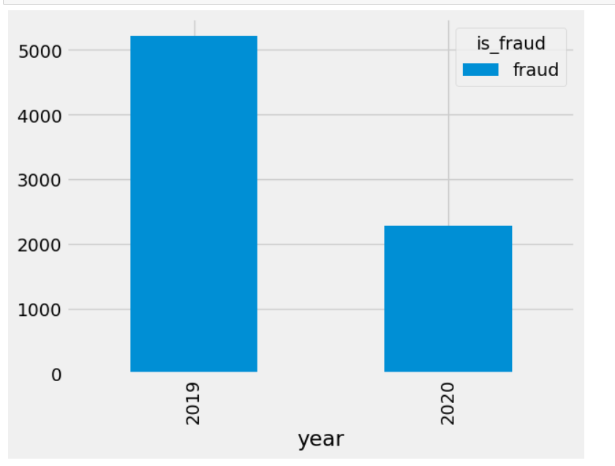
1) WHICH TYPES OF TRANSACTION IS MORE OCCURRED.
2)
IN WHICH YEARS MORE NUMBER OF FRAUD TRANSCATIONS IS OCCURRED.
interpretation
interpretation
It can be seen that in 2019 there were more fraud transactions compared to 2020
it can be seen that the number of fraud transactions that occurred from 2019 to 2020. was more.

Slide 6
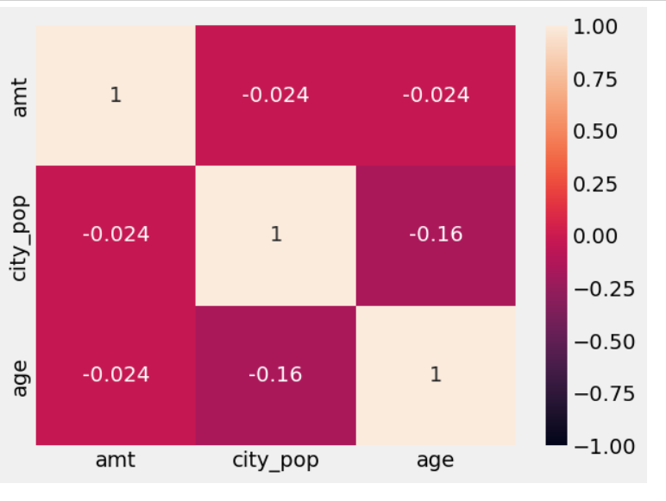
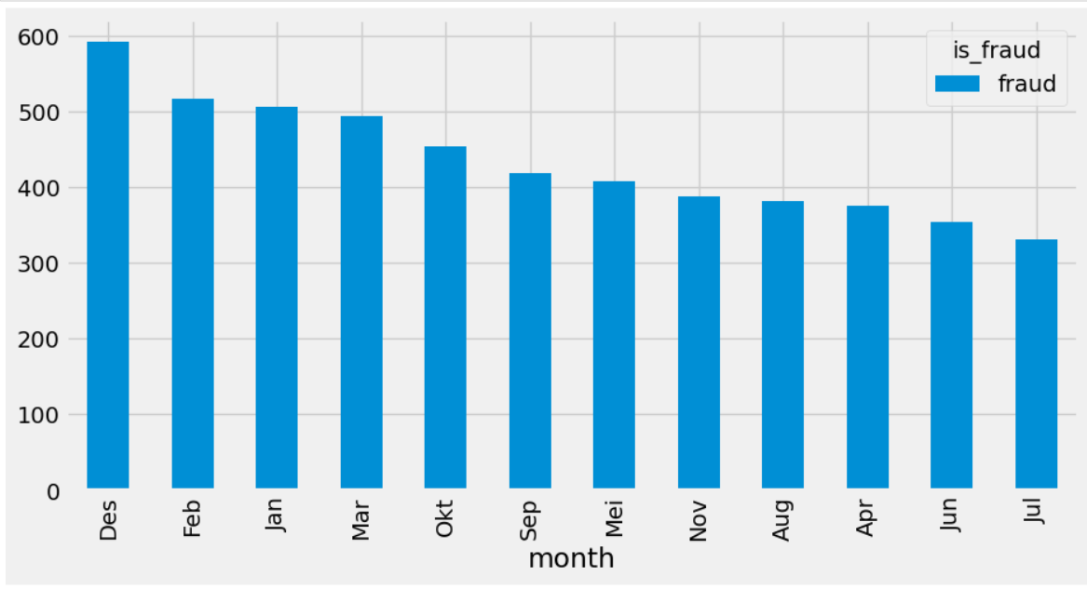
3) IN WHICH MONTH MORE NUMBER OF FRAUD TRANSCATIONS IS OCCURRED.
4)
METHODS OF OF USING HEAT MAPS AND CORRELATION ANALYSIS
interpretation
interpretation
DARKER COLOUR INDICATES THE HIGHTEST VALUES,IF THE BOX IS LARGER,VALUE WILL BE LARGER
More fraud transactions is month of December in different months in different years

Slide 7
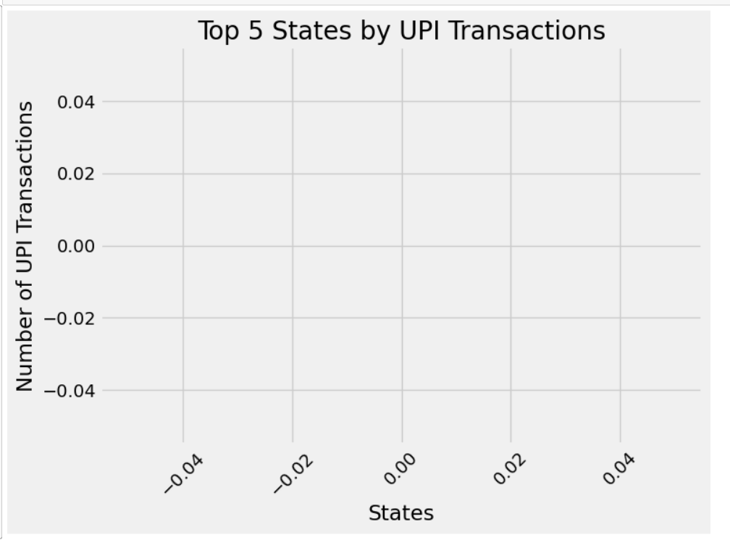
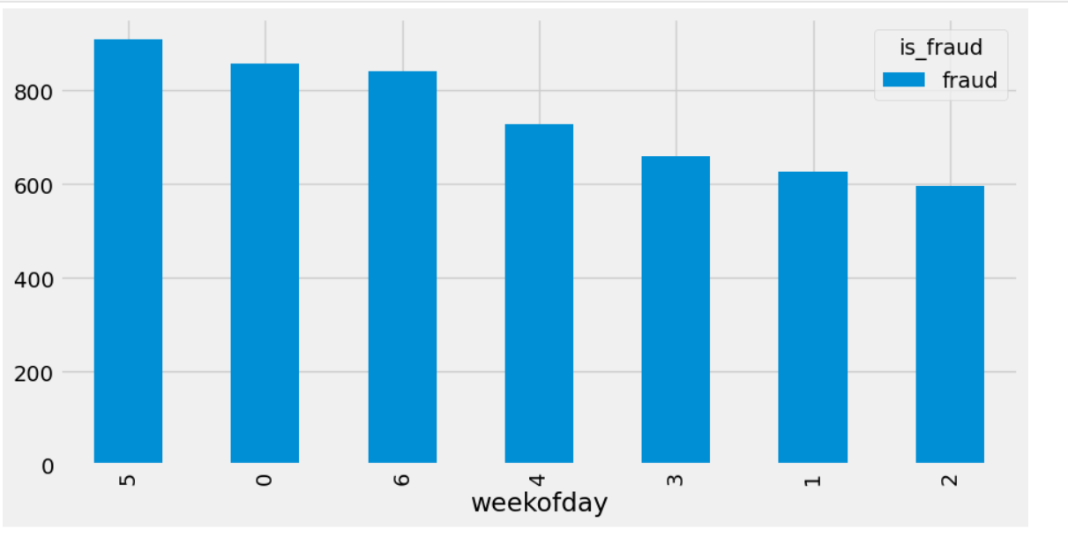
DISTRIBUTION OF TRANSCATIONS AMOUNT BY PAYMENT CATEGORIES
5)
6)
TOP 5 STATES OF UPI TRANSCATIONS
INTERPRETATION
INTERPRETATION
This bar chart highlights that 'State A', 'State B', and 'State C' have the highest UPI transaction counts.
5 week of day has more fraud transcations.

Slide 8
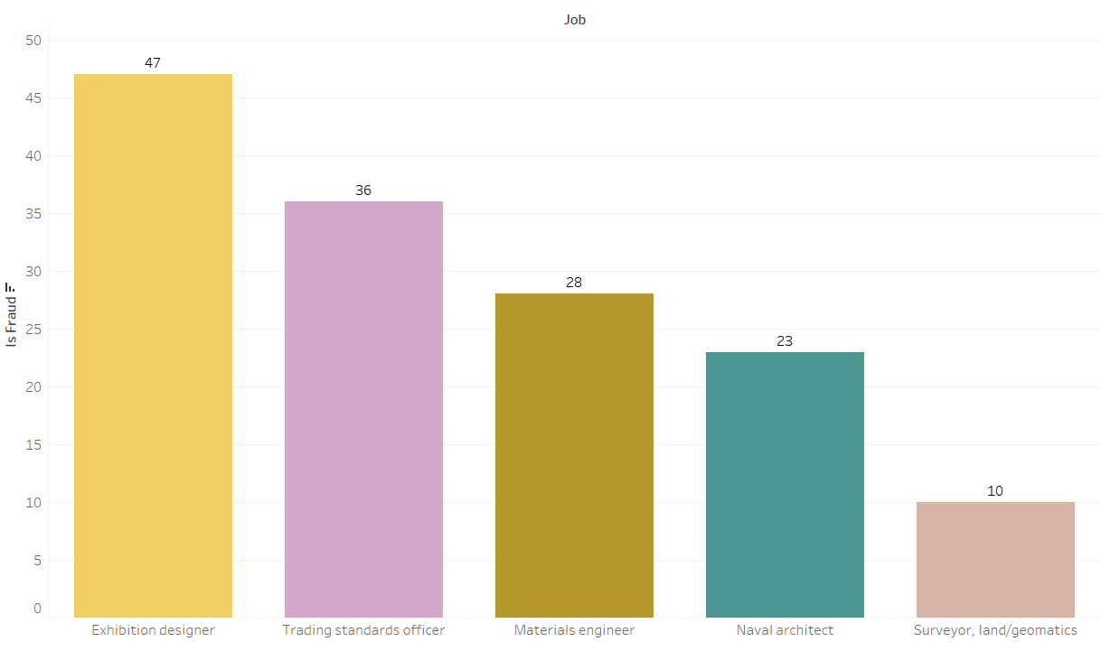
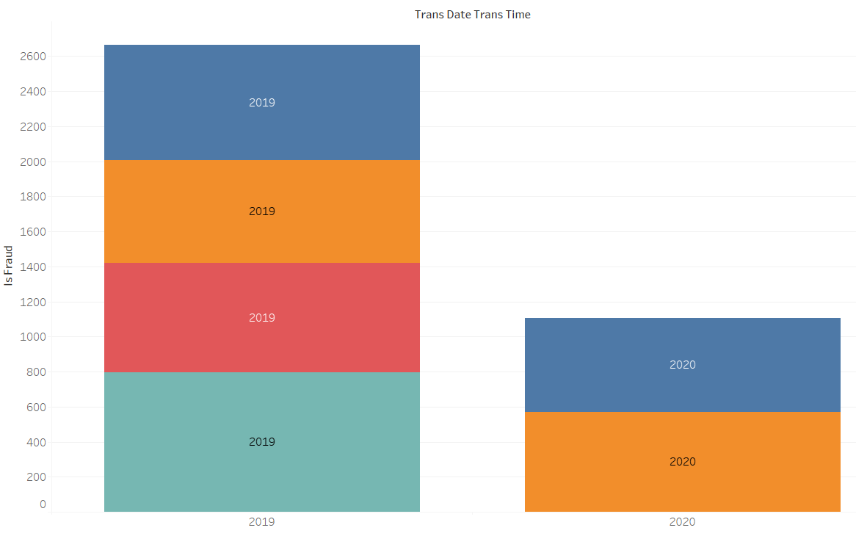
1) TOP 10 JOBS WITH HIGHTEST FRAUD TRANSCATIONS.
IN WHICH TRANS DATE TRANS TIME HAS MORE FRUAD TRANSCATIONS.
2)
INTERPRETATION
INTERPRETATION
2019 HAS MORE FRUAD TRANSCATION COMPARED TO OTHER YEAR.
EXHIBITION DESIGNER HAS MORE FRAUD TRANSCATIONS COMPARED TO OTHERS.

Slide 9
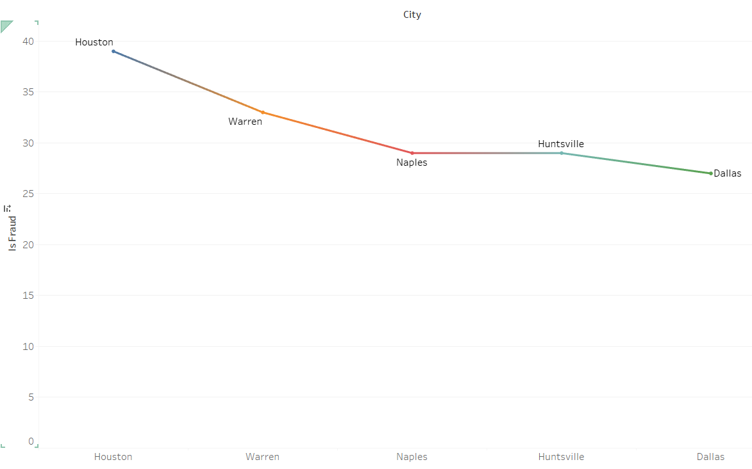
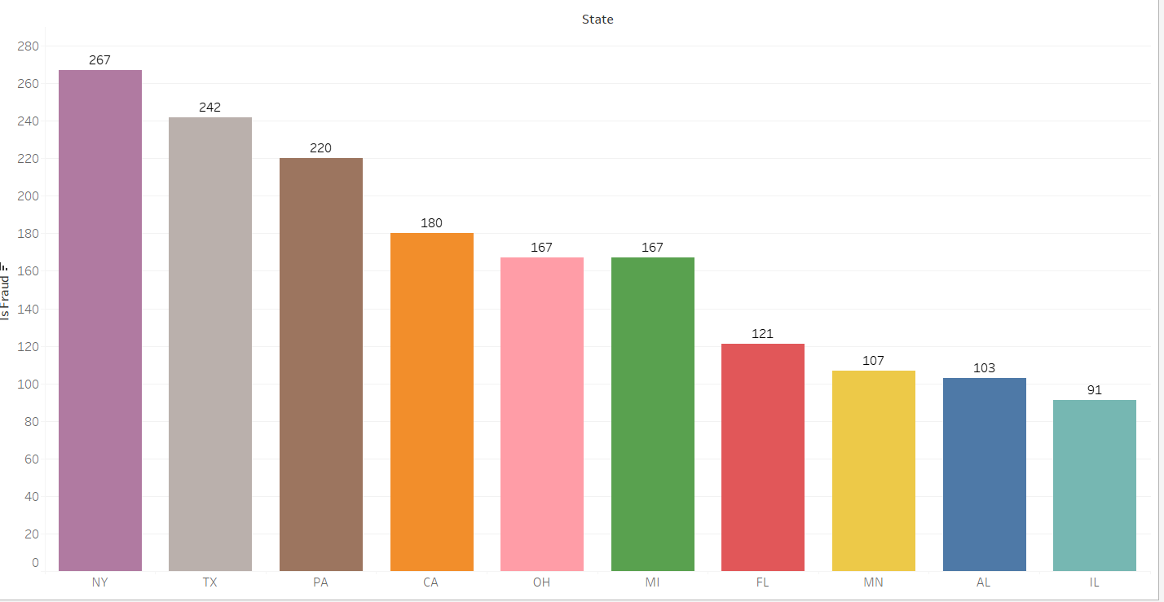
3) IN WHICH STATES MORE NUMBERS OF FRAUD TRANSCATIONS IS OCCURRED.
IN WHICH CITY HAS THE MORE FRAUD TRANSCATIONS
4)
INTERPRETATION
INTERPRETATION
TX STATE HAS THE MORE FRAUD TRANSCATIONS.
THE HOUSTON CITY HAS THE MORE FRAUD TRANSCATIONS TO OTHERS.

Slide 10
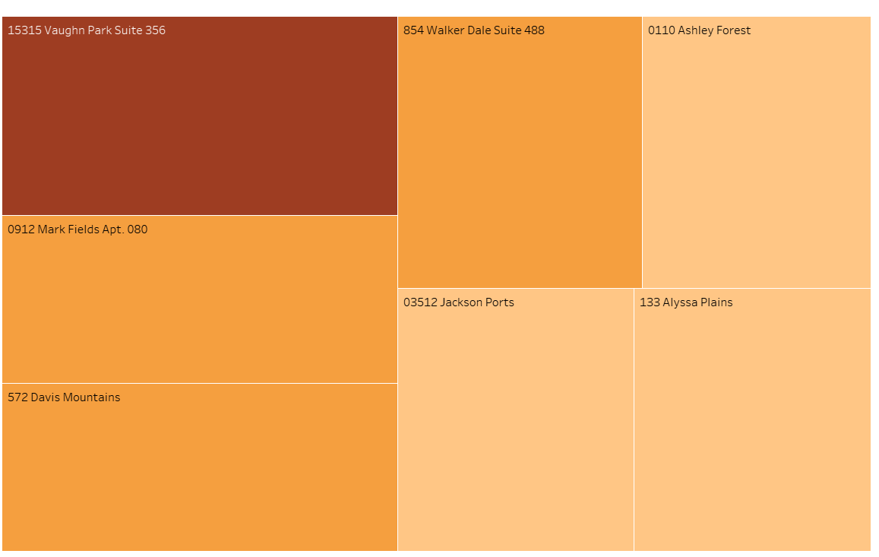
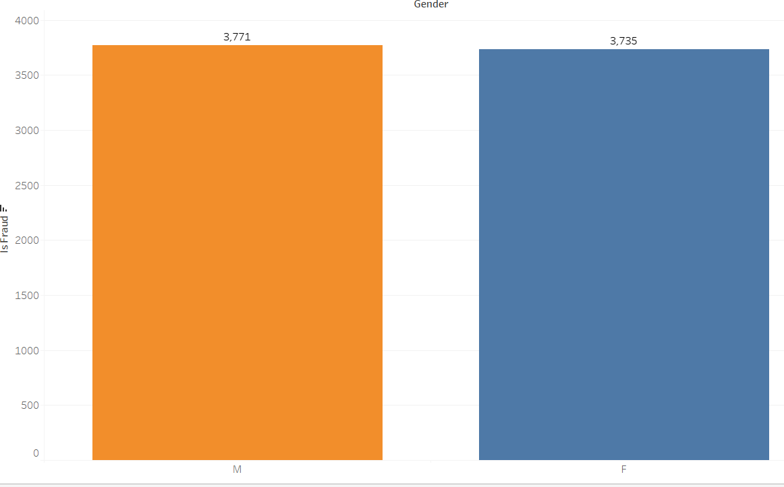
5) IN WHICH STREETS MORE FRAUD TRANSCATIONS IS OCCURRED.
6)
WHICH GENDER IS MORE FRAUD
INTERPRETATION
INTERPRETATION
GENDER IS HAVING MORE FRAUD COMPARED TO OTHERS.
THE STREETS 15315 VAUGHN PARK SUITE 356 HAS MORE FRAUD TRANSCATION TO OTHERS.

Slide 11
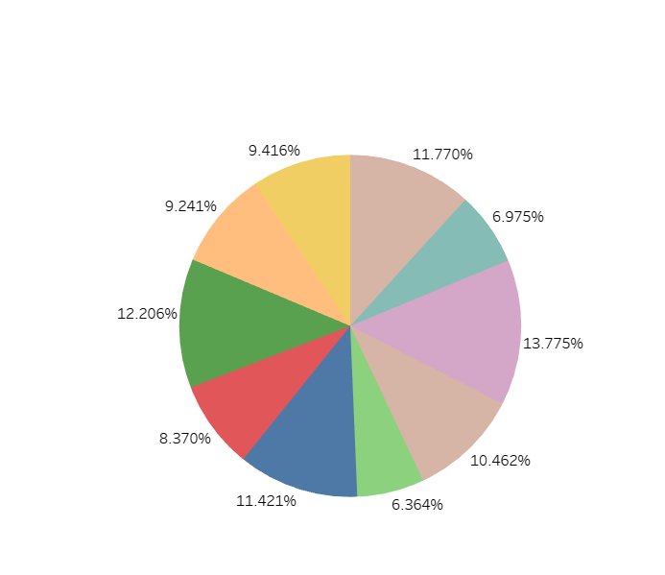
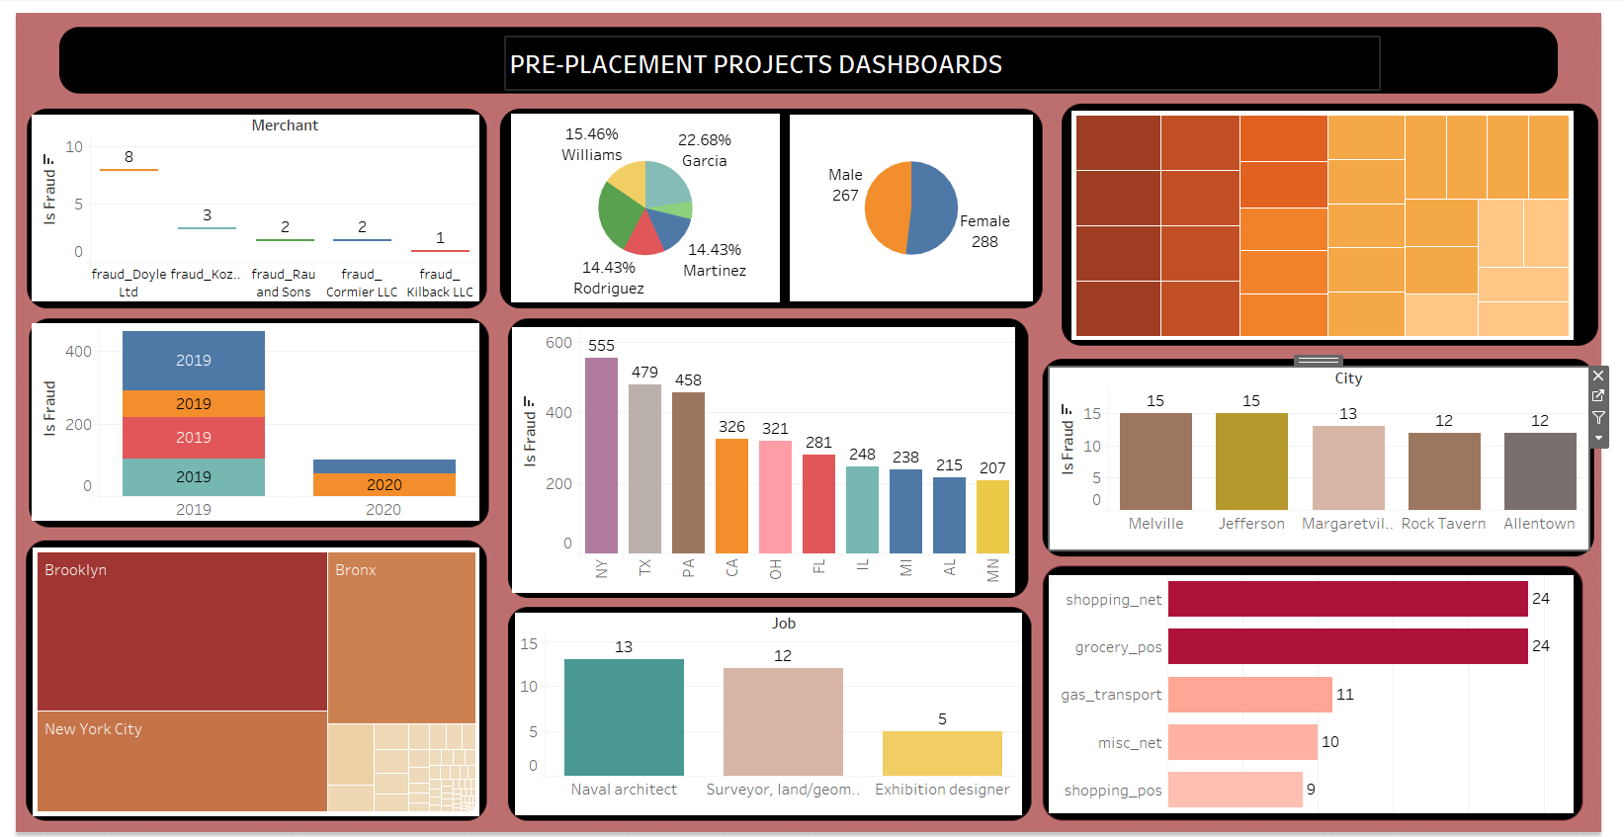
7) IN WHICH LAST(COLUMNS) MOST FRAUD OCCURED
8)
DASHBOARD
INTERPRETATIONS
JOHNSONS HAS THE MOST FRAUD IN LAST (COLUMNS )TRANSCATIONS.

Slide 12
CONCLUSION
The study of UPI and its applications has shown that UPI has revolutionized the digital payment industry in India.
It offers a seamless and secure payment experience, making it a popular payment option for individuals and businesses alike.
The adoption and usage rates of UPI have been increasing rapidly, with UPI transactions growing at an unprecedented rate.

